Slide 1
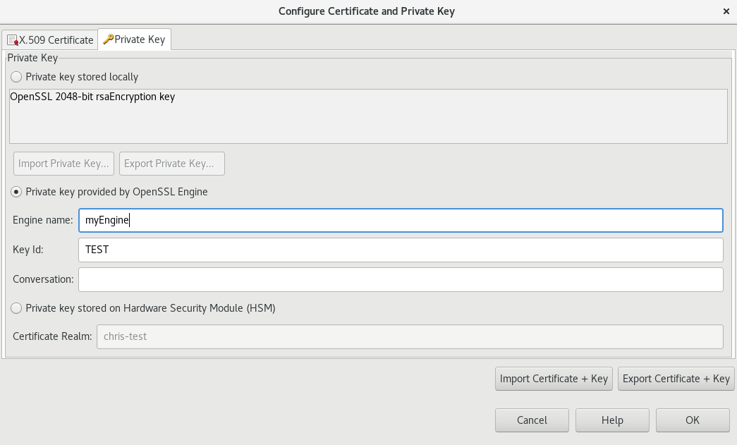
How HSM works today? With the Axway API-Gateway
HSM
API-Gateway (JVM)
conf/providers.json: lib/libCryptoki2_64.so
Each configured provider, will be initialized on API-Gateway startup.
Engines
conf/realms.json
Certificate-Aliases
vpkcs11
vcoreng
Not engine based – Just a local keystore
.... (maybe custom)
CertStore
getPrivateKey(engine, keyId)
Engine: AnyEngine
Same Code
Engine: vkpcs11 (Cert.-Realm is the keyId)

Slide 2
Why it fails When using IBM-MQ
HSM
API-Gateway (JVM)
conf/providers.json: lib/libCryptoki2_64.so
java.security security.provider.11=sun.security.pkcs11.SunPKCS11 ..security/pkcs11.cfg
Engines
pkcs11.cfg name = myhsmcfg
slotListIndex = 0
description = My HSM device
library = lib/libCryptoki2_64.so
attributes(*,CKO_PRIVATE_KEY,*) = {
CKA_PRIVATE = true
CKA_TOKEN = true
}
conf/realms.json
Certificate-Aliases
vpkcs11
vcoreng
.... (maybe custom)
CertStore
getPrivateKey(engine, keyId)
Both PKCS#11 providers (Axway & IBM) are initializing the same connection to the same HSM.
Both PKCS#12 providers are initializing the same connection to the same HSM.

Slide 3
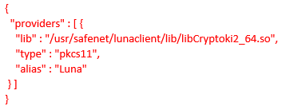
Summary
The API-Gateway is using engines that include different providers
The engine used for the HSM-Communication is: „vpkcs11“
Providers are configured in providers.json
To support IBM-MQ with AMS the PKCS#11 provider must be registered within the Engine as IBM is expecting it
Ultimately this step should not be necessary as the PKCS#11 Provider already exists, based on the engine configuration security.provider.11=sun.security.pkcs11.SunPKCS11 ${java.home}/lib/security/pkcs11.cfg
Only when having it as part of an Engine, it can be used by the API-Gateway CertStore

Slide 4
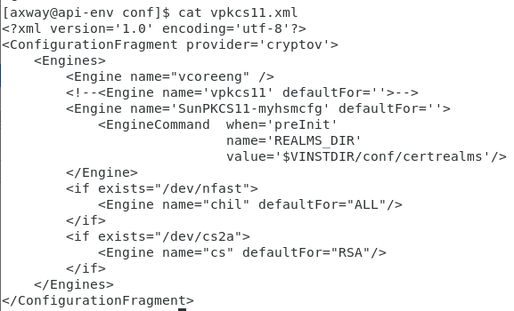
Notes
CertStore is using Engine.get(EngineName) to get the underlying engine
Configuration is kicked off by class OSSLProvider.class
That is loading library: ossljce
Engine.get() is a Native library (ossljce/jengine.cpp)
Available engines are configured based on
service.xml -> vpkcs11.xml --> handled by cryptov (Native module) → engine.cpp → Engine::configure
Loops over all configured engines and creates a map: engine[engineName]
This code is based on the libraries in platform/lib/engines/*
vpkcs11 → (Native module vpkcs11 → e_vpkcs11.cpp)
vpkcs11 uses the given preInit to configure providers & realms

Slide 5
What this project provides Provides a lookup of private and public keys with new PKCS11 Security provider
HSM
00003: Own Private key
API-Gateway (JVM)
conf/realms.json
00003 → key.ks
Java-Keystore
PKCS11KeystoreSpi (Axway)
engineGetKey(String alias, char[] pw) {…
engineContainsAlias(String alias) {…
engineGetCertificate(String alias) {…
engineGetCertificateChain(String alias) {…
engineAliases()
keystore.conf pkcs11.provider=AxwayAPIGWPKCS11
pkcs11.certificate=00003
pkcs11.token = AX-TEST-HA <<< Not used (it does not use the pkcs11.token attribute in the keystore.conf which is only used by native applications (C/C++)
pkcs11.secondary_keystore=.mqs/keystore_pkcs.jks
pkcs11.secondary_keystore_pass=<password>
getKey(00003, PWnotUsed)
containsAlias(00003)
getCertificate(00003)
getCertificateChain(00003)
IBM MQ-Lib
API-Gateway Certificate-Store
00003: Partn-Public key

Slide 6
Send encrypted message to partner Encrypted with public key fom partner
HSM
00003: Own Private key
API-Gateway (JVM)
conf/realms.json
00003 → key.ks
Java-Keystore
PKCS11KeystoreSpi (Axway)
engineGetKey(String alias, char[] pw) {…
engineContainsAlias(String alias) {…
engineGetCertificate(00003) {…
engineGetCertificateChain(String alias) {…
engineAliases()
keystore.conf pkcs11.provider=AxwayAPIGWPKCS11
pkcs11.certificate=00003
pkcs11.token = AX-TEST-HA <<< Not used (it does not use the pkcs11.token attribute in the keystore.conf which is only used by native applications (C/C++)
pkcs11.secondary_keystore=.mqs/keystore_pkcs.jks
pkcs11.secondary_keystore_pass=<password>
getKey(00003, PWnotUsed)
containsAlias(00003)
getCertificate(00003)
getCertificateChain(00003)
IBM MQ-Lib
API-Gateway Certificate-Store
00003: Partn-Public key

Slide 7
Receive encrypted message from partner Decrypt received message with our own private key
HSM
00003: Own Private key
API-Gateway (JVM)
conf/realms.json
00003 → key.ks
Java-Keystore
PKCS11KeystoreSpi (Axway)
engineGetKey(String alias, char[] pw) {…
engineContainsAlias(String alias) {…
engineGetCertificate(00003) {…
engineGetCertificateChain(String alias) {…
engineAliases()
keystore.conf pkcs11.provider=AxwayAPIGWPKCS11
pkcs11.certificate=00003
pkcs11.token = AX-TEST-HA <<< Not used (it does not use the pkcs11.token attribute in the keystore.conf which is only used by native applications (C/C++)
pkcs11.secondary_keystore=.mqs/keystore_pkcs.jks
pkcs11.secondary_keystore_pass=<password>
getKey(00003, PWnotUsed)
containsAlias(00003)
getCertificate(00003)
getCertificateChain(00003)
IBM MQ-Lib
API-Gateway Certificate-Store
00003: Partn-Public key

